Slide 1

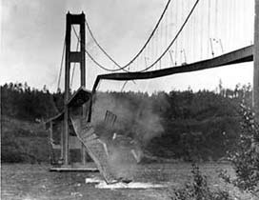
Module U08182 – Information Systems Design
Lecture 9 - Testing Principles
Lecture 10 - Testing Practice
C Cox - 2014
Testing as part of the design process
Testing basics
Verification and Validation
Static testing
- Modeling, Inspection & Code Analysis
Use Case and Scenario testing
Formal Methods
School of Technology
Notes:
U08182
C Cox
photo US Tomaha bridge failure, 1940

Slide 2
The Purpose of Testing?
Is looking for the (possible) presence of errors
Programs typically have 1-3 bugs per 100 lines
A successful test is one that reveals a defect
Each test should have a specific purpose – so is not redundant
Running a program is not testing (though it may be beta testing)
Debugging is not testing
May not provide a quality guarantee
C Cox - 2014
Actuality Test result | System has no errors | System has errors
Error found | False Alarm – testing error | Correct
No error found | Correct | Missed the error
School of Technology
Notes:
U08182
C Cox
Activities in a typical software life cycle model may include the following:
· Quality Planning
· System Requirements Definition
· Detailed Software Requirements Specification
· Software Design Specification
· Construction or Coding
· Testing
· Installation
· Operation and Support
· Maintenance
· Retirement

Slide 3
Four stage systems development life cycle model
Stage | Activity | Deliverable | SQA
Requirements (Specify What) | Tender Feasibility Systems analysis | Tender Feasibility Requirement spec | Project set-up Requirements review
Design (specify how) | System design | Test Plan Design spec | Design review
Implementation (Build) | Programming Testing Verification | User guide Release notes Software reference doc. | Release Validation Acceptance testing
Operation | Training Support Maintenance | Training request Enhancement request Bug report | Change request
C Cox - 2014
School of Technology
Notes:
U08182
C Cox
Activities in a typical software life cycle model may include the following:
· Quality Planning
· System Requirements Definition
· Detailed Software Requirements Specification
· Software Design Specification
· Construction or Coding
· Testing
· Installation
· Operation and Support
· Maintenance
· Retirement

Slide 4
Testing through the ‘V’ life cycle stages
Life cycle stage
Level of testing
Requirements
(customer spec)
System meets
Customer approval
Acceptance test(Validation)
Analysis
Software spec
System meets
Software spec.
System test (Verification)
C Cox - 2014
design
System build
Test ok
Integration test
Module
specification
module
Test ok
Unit
test
design
abstraction
programming
development time
School of Technology
Notes:
U08182
C Cox
In the ’V’ life cycle model the x axis shows time and the y axis shows the level of design abstraction. At the top is the customer view, at the bottom the program code.
Verification activities are generally on the V model l.h.s, e.g. confirming that design is based on requirements, then code is based on design etc while Validation activities are on the r.h.s where the product is checked and tested

Slide 5

Validation – does the system do what the users want ?
Demonstrate that system satisfies users requirements
Concerns the software product
Normally assessed using dynamic testing
  Performance Testing
  Regression Testing
  Acceptance Testing
  Usability Testing
  Stress Testing
  Security Testing
  Recovery Testing
  Alpha and Beta Testing
C Cox - 2014
School of Technology
Notes:
U08182
C Cox
Software validation is a part of the design validation for a finished device. It ensures that the output of a life cycle stage (or more usually the complete system) is correct. I.e. that the system behaviour, operation or output conforms to the customers specification. For example a complete system validation is commonly termed acceptance testing. Validation is also concerned that the system components and build procedures are traceable to the customers specification (Ince, 1994). Validation is therefore a check on the overall system quality. Further, validation could be applied incrementally, for example as part of a prototyping design methodology approach
Software validation can be defined as confirmation by examination and provision of objective evidence that software specifications conform to user needs and intended uses, and that the particular requirements implemented through software can be consistently fulfilled.
In practice, software validation activities may occur both during, as well as at the end of the software development life cycle to ensure that all requirements have been fulfilled.
Since software is often part of a larger hardware system, the validation of software typically includes evidence that all software requirements have been implemented correctly and completely and are traceable to system requirements. A conclusion that software is validated is highly dependent upon comprehensive software testing, inspections, analyses, and other verification tasks performed at each stage of the software development life cycle. Testing of device software functionality in a simulated user environment, and user site testing are typically included as components of an overall design validation program for a software automated device.

Slide 6
Verification – are we following the design process ?
Ensure component or system works (conforms) to its specification, i.e. the output conforms to its inputs (even if the specification is incorrect)
Concerns the development process
Applies to complete system (product), or to separate development stages (process)
Includes both static and dynamic testing activities
Includes process traceability
Not the same as demonstrating correctness – i.e. usually does not provide any check or proof as to the correctness of a system
Program verification, which includes formal methods, may provide a high level of quality assurance.
C Cox - 2014
School of Technology
Notes:
U08182
C Cox
Software verification provides objective evidence that the design outputs of a particular phase of the
software development life cycle meet all of the specified requirements for that phase, I.e. verification is applied between stages as a check on the design process. Software verification looks for consistency, completeness, and correctness of the software and its supporting documentation, as it is being developed, and provides support for a subsequent conclusion that software is validated. Software testing is one of many verification activities intended to confirm that software development output meets its input requirements. Other verification activities include various static and dynamic analyses, code and document inspections, walkthroughs, and other techniques. Verification is achieved if the stage output meets the specification, even if the specification is incorrect. Verification therefore does not provide any check or proof as to the correctness of a system
Software verification and validation are difficult because a developer cannot test forever, and it is hard
to know how much evidence is enough. In large measure, software validation is a matter of developing
a “level of confidence” that the device meets all requirements and user expectations for the software
automated functions and features of the device. Measures such as defects found in specifications
documents, estimates of defects remaining, testing coverage, and other techniques are all used to
develop an acceptable level of confidence before shipping the product. The level of confidence, and
therefore the level of software validation, verification, and testing effort needed, will vary depending
upon the safety risk (hazard) posed by the functions of the system.

Slide 7
Testing Basics
Is the process used to verify or validate a specification, system or unit
Is part of the design process (proactive), not a response to it (reactive)
Types of testing
- modelling: investigate behaviour of model of system
- static and dynamic testing
- module, integration and acceptance (validation) testing
Levels of testing
  black box and white box testing
  coverage
  Test adequacy
The Test Plan – testing procedure and documentation
C Cox - 2014
School of Technology
Notes:
U08182
C Cox
Dijkstra – “testing can be used to prove the presence of bugs, but not their absence”
Testing is a proactive activity, whereas debugging is a reactive activity
Testing is a key element of any design methodology. In particular there should be a test plan or strategy for any system development and design for testability should be a consideration
Static Testing – applied without running or operating system
Dynamic Testing – involves operating the real system
Testing within the systems development lifecycle
Static analysis
Module Testing
Coverage Measurement
White box testing
Integration testing
System testing
Acceptance testing

Slide 8
Static (non-execution) Testing Techniques (this lecture)
Modelling
Reviews
Inspection
Walkthroughs
Desk Checking / Trace Table
Control Flow Analysis – McCabe
Symbolic execution
Scenario (Use Case) Testing
Control Flow testing
Formal methods
C Cox - 2014
School of Technology

Slide 9
Dynamic (execution) Testing Techniques (week 10)
Structural (white box)
Control flow
  Statement
  Branch/decision
Behavioural
Functional
  Equivalence partitioning
  Boundary value analysis
  Random testing
Non-functional
  Usability
  Performance
C Cox - 2014
School of Technology

Slide 10
Black Box Testing
Test against the system functional specification
Can reveal errors in the design process (requirements, design, implementation)
Generally less complex and costly to perform (than white box)
Test coverage related to requirements and exceptions tested, so related to behaviour not code structure
White Box Testing
Considers the internal code structure, so capable of detecting subtle faults, e.g. by testing all code paths
Can be complex or even impractical for some programs
Has limited capability in detecting requirements and design errors
C Cox - 2014
Often use a combination of black box and white box testing
Black box to confirm external specification
White box to provide test adequacy, e.g. by code path coverage
School of Technology

Slide 11
Testing Adequacy
Non functional requirement describing how thoroughly a system should be tested
Complete testing is usually impossible (too many input combinations, too many control paths, complex user interface etc)
Used to specify
  When to stop testing (e.g. safety requirement, testing costs)
  A measure of testing quality (e.g. % coverage)
  How to generate test values (Specification based - generally black box or Program based - generally white box)
  Measure testing progress but note 100% code coverage does not imply 100% tested.
Techniques
  test coverage measurement (e.g. lines, branch or path)
  fault seeding (e.g. mutant score = % of planted faults detected)
  Scenario testing
C Cox - 2014
School of Technology

Slide 12
Test Driven Development (TDD)
- A test first software development approach
- Popular technique with Extreme Programming
Concept:
Write the test first, before the code for each new or reworked feature
Each test based on a use case
Simple tests that each returns true (success) of false (fail)
Ensure test fails with incorrect implementation but passes when correct
Code complete when it passes all tests
Develop an automated test suite of all the tests = test suite ok if all tests ok
Refactoring (Martin Fowler) – concept: make improvements to code implementation without changing the specification, e.g. improve readability, maintainability, performance etc
Techniques
  test coverage criteria (e.g. lines, branch or path)
  fault seeding (e.g. mutant score = % of planted faults detected)
C Cox - 2014
School of Technology

Slide 13
Static Testing
Modelling
Inspection
- Formal Review
- Code analysis
- Trace table
- Control flow analysis
- Symbolic execution
- Scenario based
Formal Methods
C Cox - 2014
School of Technology

Slide 14
Modelling (approach to testing)
Investigate behaviour of an appropriate system model, e.g. a mathematical model
Usually applied early in the system life-cycle
Can be used to formulate a system specification, for subsequent systems design and validation
Does not test actual system or program code
Some properties cannot be tested by modelling, e.g. reliability
Example tools: UML, Matlab Simulink, Z etc.
C Cox - 2014
School of Technology

Slide 15
Static Testing: Inspection
A step-by-step reading of the software engineering product, with each step checked against a predetermined list of criteria, called check list.
These criteria usually include checks for historically common errors, adherence to programming standards, and consistency with program specifications.
Inspection requires a team of testers including the software developer.
The developer narrates the reading of the product and finds many errors just by the simple review act of reading aloud.
Other errors are determined as a result of discussion with team members and by applying the checklist.
C Cox - 2014
School of Technology

Slide 16
Static Testing Methods: The Formal Review
Applicability:
  Designs, program codes and various documents produced at various stages of development
The purpose:
  To analyse internal consistency, satisfaction of requirements, and suitability for implementation
Technique: Walk-through
  Test data are selected and the software is simulated manually.
  The test data are "walked through" the system, with intermediate results kept on a blackboard or a sheet of paper
The key issues:
  Keep the test data simple
  Encourage discussion, not just to complete the simulation
  Most errors are discovered by questioning the developer's decisions, rather than by examining the test data
C Cox - 2014
School of Technology

Slide 17
Life cycle structured walkthrough - principles
Review of deliverables/products documentation at the end of a life cycle stage
Objective is to identify errors, omissions and to initiate necessary corrective action
Walkthrough types: formal (with client/customer) or informal (internal)
Review team size: minimum 3, maximum 7
Team member roles: chair, secretary, document author, reviewers, optional user/customer/client, optional observer (from project team) and optional independent observer
Objective:
  to ensure document/product meets the requirements and conforms to the appropriate quality standards
  Identify errors and omissions
Examples: Fagan, Agile Scrum etc
C Cox - 2014
School of Technology
Notes:
U08182
C Cox
Walkthroughs/ design reviews - peer review involving the systematic investigation of documents, called a code walk-though This
requires an engineer to lead colleagues through the design or implementation of software and to convince them of its correctness.
Aim: To detect faults in some product of the development as soon as possible in the development cycle.
Software reviews are a "filter" for the software engineering process.
Reviews are applied at various points during software development and serve to uncover defects that can then be removed.
A person can often spot some of their own mistakes, but a group of people are more likely to spot more of the mistakes.
A Formal Technical Review is a software quality assurance activity that is performed by software engineering practitioners.
The objectives of the FTR are:
To uncover errors in function, logic, or implementation for any representation of the product (hardware, software, safety).
To verify that the product under review meets its requirements.
To ensure that the product has been developed according to the predefined standards.
To achieve a product that is developed in a uniform manner.
To make projects more manageable.
To ensure a projects quality.

Slide 18
Structured walkthrough - stages
Preparation – document author (presenter) passes the document to the chair (in good time) for distribution to the review team members, together with notification and agenda of the review meeting
Walkthrough meeting – in which actions and comments are identified, agreed and recorded by the secretary. The overall review meeting outcome can be:
  Accept and approve the document/product
  Recommend minor revision, with no need for further review
  Recommend major revisions and schedule a further review
Follow up – address outcome of the review meeting
C Cox - 2014
School of Technology
Notes:
U08182
C Cox
FTR review meeting procedure:
Typically between 3 to 5 people in the review team.
Advance preparation should occur with no more than 2 hours work per person.
The duration of the review meeting should be less than 2 hours.
The review meeting records should document:
What was reviewed, Who reviewed it, The findings and conclusions

Slide 19
Scrum – Meetings
Daily Scrum – to review project status
Members come prepared with updates
Punctual start, same location & time each day
Max 15 mins
Core roles speak
All team welcome to attend
Discuss progress, plans & problems (since yesterday)
Documented by scrum manager
Detailed discussions is outside scope of daily scrum meeting
C Cox - 2014
C Cox
Sprint review
Review of sprint work
Present/demo to stakeholders
4 hour max
School of Technology
U08784 Software Project Management

Slide 20
An example of a review checklist for coding.
1. Has the design properly been translated into code?
2. Are there misspellings and typos?
3. Has proper use of language conventions been made?
4. Is there compliance with coding standards for language style,
comments, module prologue?
5. Are there incorrect or ambiguous comments?
6. Are data types and data declarations accurate?
7. Are physical constants correct?
8. Have all the items on the design walkthrough checklist been
reapplied as required?
C Cox - 2014
School of Technology
Notes:
U08182
C Cox

Slide 21
Static Code Inspection Analysis Techniques
Boundary value analysis to examine behaviour at boundaries of input domain
Control flow analysis – code analysis using directed graphs to analyse program control structures (e.g. unreachable code)
Program Code analysis e.g. LINT, a post compiler for C to check that language rules are applied. Also –Wall –ansi –pedantic with gcc.
Trace table for manual check of program operation using data values
Symbolic execution – program is traced manually or automatically (semantic analyser) using algebraic variables as data (unlike trace table where actual data is used) so that statements produce algebraic expressions. Resulting formulae for each code path then compared to its specification
Cyclomatic complexity (e.g. Halstead) – complexity of design or code control structure
C Cox - 2014
School of Technology

Slide 22
Static Testing – Program Code Analysis
Are all variables
defined?
Are language rules
strictly applied
(e.g. LINT for C)
if a > b
c := d
else if a <= b
foo(a, d)
else
d := 2
Are all variables
set before use?
C Cox - 2014
Are procedures
used consistently
Is there any
unreachable code?
Are local conventions
followed?
Analysers such as
MALPAS/SPADE
School of Technology
Notes:
U08182
C Cox
7
Code Analysis can cover many forms of testing. Some of the checks which can be made on source code will vary between languages. LINT for example is a program which cheeks for the strictest possible adherence to the C language. This reflects the fact that C allows programmers to do 'silly' things. Many of LINTs checks would be done by the compiler in another language. In some languages (e.g. BASIC, FORTRAN) variables do not have to be explicitly defined, accidentally misspelling a variable name can have a disastrous effect (one of the early US space rockets had to be blown up in the air because of a such a fault).
A number of proprietary products such as MALPAS & SPADE (aimed mostly at the real time market) will do much more rigorous checking of the logic of programs. Apart from checks which could be made by compilers (unreachable code, variables used before they have been given a value) such products provide detailed analysis of conditions for entry to and exit from modules and compare them to programmer provided specifications.
If local programming conventions are used (for example rules for naming variables, maximum allowed depth of nesting of if/while statements tic) then testing should also include ensuring that such conventions are followed. This may require specially written software.

Slide 23
Static Testing - Trace Table – Example 1
Line N guess output
2 Guess the number game
4 1
Enter first guess
25
2
Enter higher number
50
8 3
Enter lower number
37
4
Enter higher number
42
16 Correct in 4 guesses
1 Program guess_the_number_game
2 output ‘Guess the number game’
3 answer=42 ! correct value
4 N:=1 ! number of guesses
5 Output 'Enter first guess: '
6 Input guess ! first guess
7 While guess<>answer
8 N:=N+1 ! count the guesses
9 If guess<answer Then
10 Output 'Enter higher number'
11 Else
12 Output 'Enter lower number'
13 EndIf
14 Input guess ! next guess
15 EndWhile
16 Output 'Correct in', N, guesses'
17End Program
C Cox - 2014
School of Technology
Notes:
U08182
C Cox
Trace through program statements

Slide 24
Static Testing - Trace Table – Example 2 (code)
. . . .
struct coordinate { int x; int y;};
typedef struct coordinate point;
struct rectangle { point lo_left; point up_right;};
typedef struct rectangle rect;
. . . .
if(inside(r,p)) printf("Inside");
else printf("Outside");
. . . .
/* function returns TRUE if point is within rectangle
and FALSE if point is on edge or outside rectangle */
int inside(rect R, point P)
{ int result;
result = (P.x > R.lo_left.x )
&& (P.x < R.up_right.x)
&& (P.y > R.lo_left.y )
&& (P.y < R.up_right.y);
return result;
C Cox - 2014
Line
1
2
3
4
5
School of Technology
Notes:
U08182
C Cox
Analysing detailed execution can involve complex code lines involving multiple predicates

Slide 25
Static Testing - Trace Table(3)
Static Testing - Trace Table – Example 2 (trace table)
10
4
P.x = 4
P.y = 10
R.lower_left.x = 3
R.upper_right.x = 5
R.lower_left.y = 7
R.upper_right.y = 9
9
7
3
5
C Cox - 2014
code line | P.x > R.lo_left.x | P.x < R.up_right.x | P.y > R.lo_left.y | P.y < R.up_right.y | result
1 | 4>3 (T)
2 |  | 4<5 (T)
3 |  |  | 10>7 (T)
4 |  |  |  | 10<9 (F)
5 |  |  |  |  | False
School of Technology
Notes:
U08182
C Cox
Use of trace table to determine intermediate and overall results

Slide 26
Boundary Value Analysis - a greater number of errors tends to occur
At the boundaries of the input domain. BVA leads to a selection of test
cases that exercise bounding values.
Aim: To remove software errors occurring at parameter limits or boundaries.
If an input condition specifies a range bounded by values α and β, test
cases should be designed with values α and β, just above and just below
α and β, respectively.
C Cox - 2014
If an input condition specifies a number of values, test cases should be
developed that exercise the minimum and maximum numbers. Values just
above and below minimum and maximum are also tested.
α
β
specification
test cases
School of Technology
Notes:
U08182
C Cox

Slide 27
Boundary value analysis (BVA)
C Cox - 2014
  faults tend to lurk near boundaries
  good place to look for faults
  test values on both sides of boundaries
invalid
valid
invalid
0
1
100
101
School of Technology

Slide 28
Boundary check on outputs
The previous two guidelines also apply to output conditions. If the output
is a sequence of data, e.g. a printed table, special attention should be paid
to the first and last elements and to lists containing 0, 1 and 2 elements.
Care with first and last output value
If internal program data structures have prescribed boundaries (e.g. an
array has a defined limit of 100 entries), be certain to design a test case to
exercise the data structure at its boundary.
C Cox - 2014
Care with internal data values
The use of the value zero, in a direct as well as indirect translation, is
often error-prone and demands special attention.
E.g. zero divisor; blank ASCII characters; empty stack or list element; full matrix (array), zero table entry
School of Technology
Notes:
U08182
C Cox

Slide 29
Control flow analysis - is a static testing technique for finding suspect areas
of code that do not follow good programming practice.
Aim: To detect poor and potentially incorrect program structures.
A directed graph represents the sequence of execution in a program module,
in which nodes represent branching points or subprogram calls in a program,
and arcs represent linear sequences of code. From the control-flow graph an
analysis can show:
- the structure of the program
- starts and ends of program segments
- unreachable code and dynamic halts
- branches from within loops
- entry and exit points for loops
- paths through the program, that can be separately tested
C Cox - 2014
School of Technology
Notes:
U08182
C Cox

Slide 30
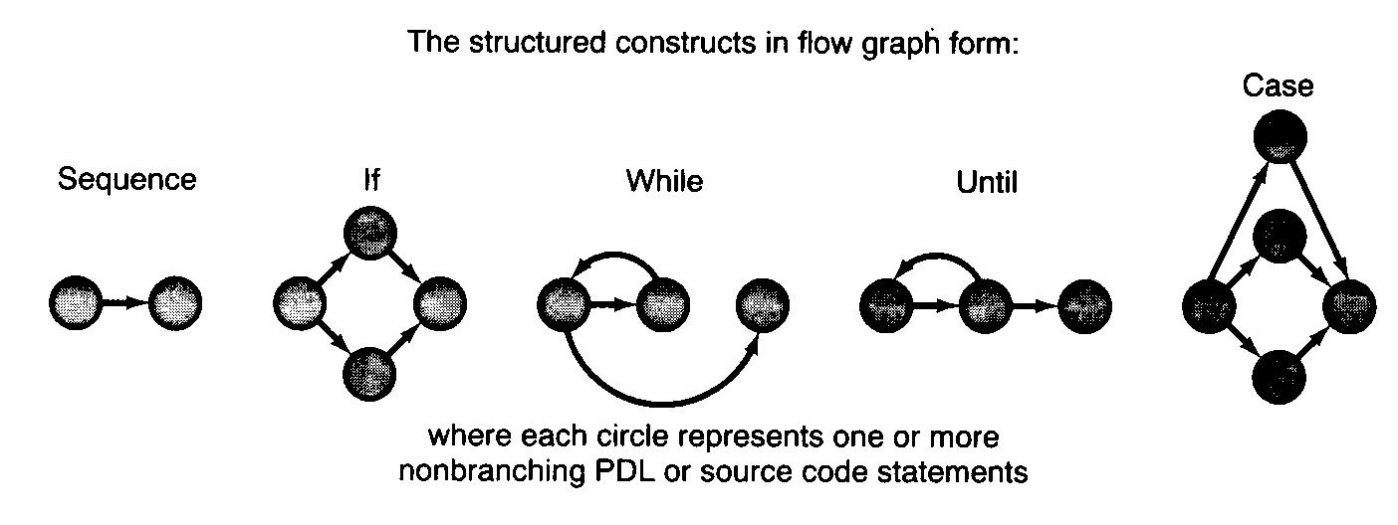
Control flow graphs of standard control structures - for McCabe Cyclomatic Complexity
For loop flow graph similar to While
C Cox - 2014
arc=code sequence
node=branch points
McCabe cyclomatic metric gives an indication
of design and testing complexity
School of Technology
Notes:
U08182
C Cox
Ref: Pressman
Based on flow graphs
Standard forms for each control structure
For loop as per while loop

Slide 31
Control Flow Analysis - examples
Start
Input n ! first
while (n<>0)
if(n>0)
root = sqrt(n)
output root
else
output ‘no root’
endif
input n ! Next
endwhile
End
Start
Input n
root = sqrt(n)
output root
End
Start
Input n
if(n>0)
root = sqrt(n)
output root
else
output ‘no root’
endif
End
C Cox - 2014
School of Technology
Notes:
U08182
C Cox
Construct flow graph from pseudocode/PDL
Arc=control flow
Node=sequence of code

Slide 32
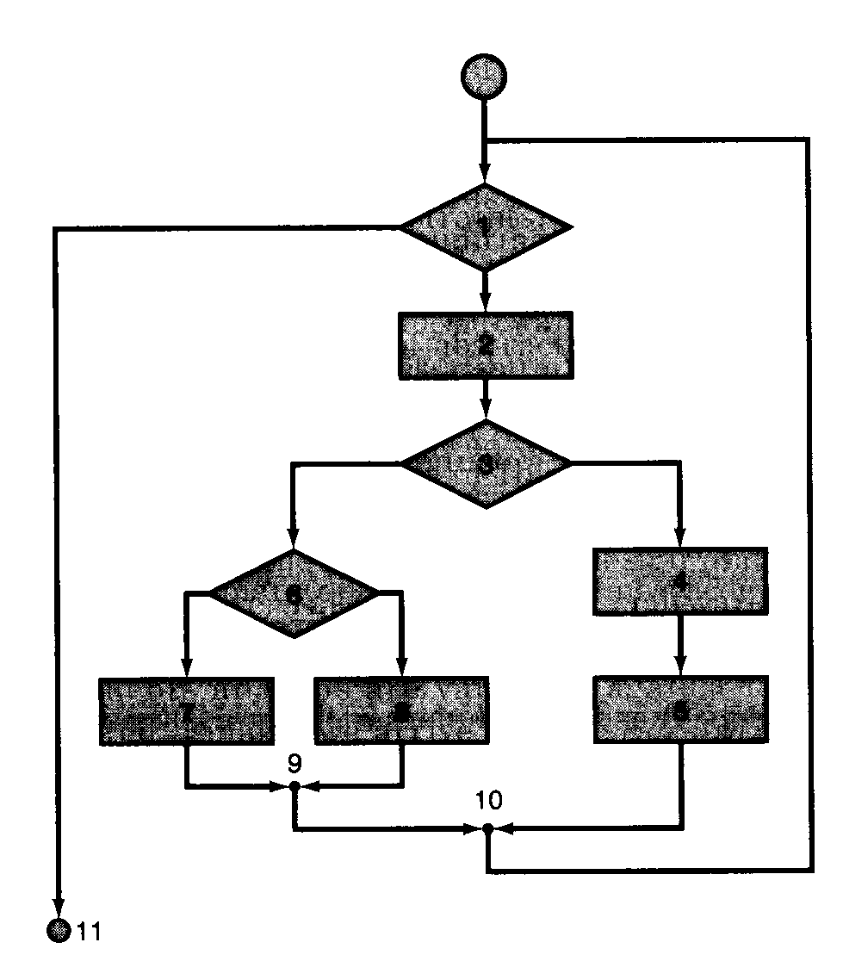
Control Structure (flowchart)
Node – control statement
Edge /arc – control flow
Corresponding program design language (pseudocode)
PDL/pseuodcode - procedure: sort
1: while records remain do
2: read record
3: if record field 1 = 0 then
4: process record
5: store in buffer and
increment counter
6: else
if record field 2 = 0 then
7: reset counter
8: else
process record
store in file
9: end if
10: end if
11: end while
1
2
C Cox - 2014
6
4
3
7
8
5
School of Technology
Notes:
U08182
C Cox

Slide 33
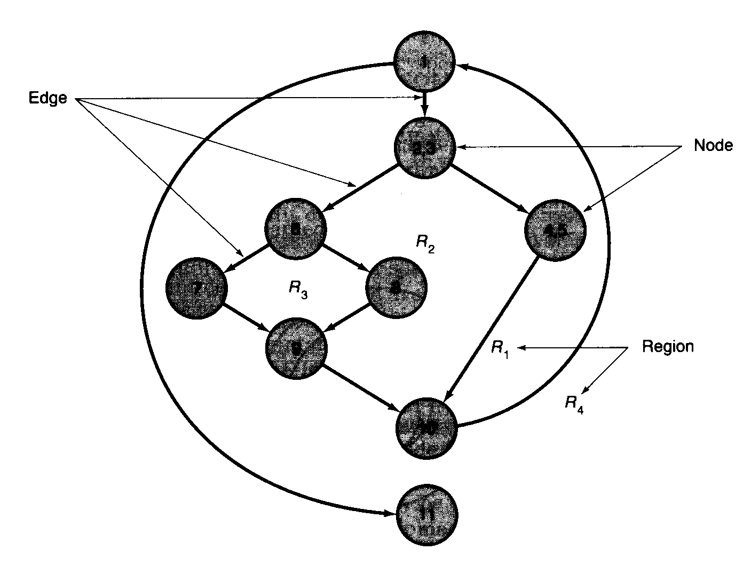
McCabe Cyclomatic complexity - is a software metric that provides a
Quantitative measure of the logical complexity of a program.
Example:
1
1. Number of regions = 4.
2. Cyclomatic complexity
V(G)=E-N+2, where E is
the number of edges and N
number of nodes ;
V(G)=11-9+2 = 4
2,3
C Cox - 2014
6
4,5
8
7
The cyclomatic complexity
V(G) provides an upper bound
on the number of tests that
must be designed and executed
to guarantee coverage of all
the program statements.
9
10
Regions (R_{i}) are areas bounded by edges (discrete control flow paths)
11
regions = arcs – nodes + 2
School of Technology
Notes:
U08182
C Cox
McCabe: Regions=Arcs-Nodes+2
Number of regions gives the number of distinct control paths, and therefore a measure of the complexity of implementation or testing.

Slide 34
Control flow analysis approaches - to test a program statically can use the following approaches:
statement testing – (coverage testing) every statement in the program is
executed at least once (finding a set of paths whose union contains all the
nodes of the graph). Design individual tests by setting values of appropriate program variables;
C Cox - 2014
condition testing – focus on exercising all the logical conditions in a program
branch testing - for every decision point in the program, each branch is
chosen at least once (finding a set of paths whose union covers all the edges
of the graph);
path (or structural) testing - every distinct path through the program is
executed at least once (need to find all possible paths through the graph).
School of Technology
Notes:
U08182
C Cox
Control flow analysis can reveal each control path allowing full structural testing to take place
Dynamic testing should attempt to cover the same tests.

Slide 35
Symbolic execution - a technique in which the input variables of a
Program are assigned symbolic values rather than literal values.
Aim: To show the agreement between source code and its specification.
Algebraic method, assumes output can be specified algebraically in terms of the inputs.
C Cox - 2014
A program is analyzed by propagating the symbolic values of the inputs
into the operands in expressions.
The resulting symbolic expressions are simplified at each step in the
computation so that all intermediate computations and decisions are
always expressed in terms of symbolic inputs.
As a result all computations and decisions are expressed as symbolic
values of the inputs.
School of Technology
Notes:
U08182
C Cox

Slide 36
Symbolic Evaluation of Program
A program is "executed" using symbols rather than actual values.
  Expression
    Substitute the symbolic (algebraic) value of each variable into the expression
    Simplify the result expression by application of algebraic laws
  Assignment
    The resulting symbolic value of the right-hand side expression becomes the new symbolic value of the variable on the left-hand side
  Conditional branching
    The predicate becomes a constraint on the symbolic value
  Output
    The symbolic value of the variables is the result
C Cox - 2014
School of Technology

Slide 37
Example of Symbolic Execution
Program Example;
Begin
Var x, y: Integer;
Input (x); Input(y);
x := x+x;
y := y*y;
IF x > y
THEN x := x – y
ELSE x:= x + y
END;
Output(x)
End
Symbolic execution
x = a y = b
x = a+a=2a
y = b*b=b²
2a>b²
x=2a-b² where 2a>b²
(x=2a+b² where 2a≤b²)
Output: 2a-b² where 2a>b²
(Output: 2a+b² where 2a≤b²)
C Cox - 2014
School of Technology

Slide 38
A Black Box Scenario Testing Approach
Produce test cases + test data from software specification
Check correctness by test execution, comparing actual against expected output/behaviour
Provide adequate test cases to cover all system functions in all scenarios
C Cox - 2014
School of Technology

Slide 39
Scenario (Use Case) Testing
Scenario – a specific sequence of actions and interactions between actors and the system
Use cases can provide basis for deriving tests for a system
Generally a Black Box test approach is taken
Static testing – each scenario can be separately reviewed
Dynamic testing – each scenario can be separately exercised
Realistic and comprehensive set of operations
Creating Scenarios considerations:
- Object life history
- All possible users and their interests
- Likely events and special events
C Cox - 2014
School of Technology

Slide 40
Business Modelling
Collection of related structural activities that are required by the organisation
Specify how a business operates, or how the system will work
Often constrained by standard business practice interfacing with other parties. E.g. service provision, transaction processing
C Cox - 2014
School of Technology

Slide 41



Business Process Definition - ICANDO Chemicals Example (Lunn, 2003)
First level – describe whole business activity
Plan | Buy | Sell | Manufacture | Develop/ Decommission | Finance | Research
C Cox - 2014
Second level – finer detail of each activity, e.g. sell
Negotiate contract
Take orders
Deliver goods
Accept returns
Invoice customer
Accept payment
Top level – tasks required for activity e.g. for invoice customer
Identify goods delivered and accepted
Price goods
Apply discount
Price invoice
Issue invoice
School of Technology

Slide 42
Use Case Specification
UML systems development documentation
Collections of related scenarios describing actor involvement
Documentation to support use case diagrams giving fine detail if the user interaction
Provides a link between user specification (what the user expects) and system specification (what the system must do)
Sequence diagrams useful to show sequence of events
Can be formalised: precondition, operation, post-condition - ideal for test specification
Provides a basis for acceptance testing
C Cox - 2014
School of Technology

Slide 43
Use Case Template
Use case name – unique identifier
Status – development state
Description - overview
Precondition – conditions required to initiate use case
Trigger – condition/s which initiated a use case
Basic course of events – primary scenario main steps
Alternative paths – dealing with unusual or exceptional events
Post condition - state after completing use case
Business process rules – how business operated in relation to use case
Notes – any additional information
History record of changes - author, date, version
C Cox - 2014
School of Technology
Notes:
U08182
C Cox
Ref: Wikipedia

Slide 44
Use Cases and Testing
As each Use Case evolves
Capture requirements
Provide development input for design and implementation
Provide basis for test cases
Provide basis for user documentation
Provides a basis for project management
Provide documentation for business customer
C Cox - 2014
School of Technology

Slide 45
Test Cases
As each Use Case evolves
Define set of conditions for a use case
Testing will determine if a requirement is satisfied in a specification, design or system implementation
Must be at least one test per test case (see adequacy later)
Documentation: test case id, pre-conditions, inputs, test procedure, expected output or post-conditions
Test result may need to be evaluated (if not simple pass/fail)
Test cases compiled into test suites
C Cox - 2014
Synonyms of ‘test case’:
test condition, test script, test scenario, test specification, test assertion
School of Technology

Slide 46
Use Case Testing - Example
Enrol on course
Use Case diagram
student
Use Case text
Main Flow
Student (Actor) Action System Response
Enrol on course
Get pre-requisites for course
Validate student qualification and conditions
Validate course state
Save the enrolment entry
Inform student
Alternative Flows
Student does not meet course conditions
The course is full
The course is closed
C Cox - 2014
School of Technology

Slide 47
Control Flow Testing – E.g. a flight check-in system
If passengers are flying with economy tickets there is possibility to upgrade to business class, especially if they hold a gold card in the airline's frequent flyer program. If economy passengers don’t hold a gold card then there is the possibility that they will be bumped off the flight if it is full and they check in late.
C Cox - 2014
School of Technology

Slide 48
Control Flow Testing – E.g. a flight check-in system
The following three tests have been run:
Test 1: Gold card holder who gets upgraded to business class
Test 2: Non Gold card holder who stays in economy
Test 3: A passenger who is bumped from the flight
C Cox - 2014
1
6
Y
gold card??
N
economy full?
Y
N
8
2
3
business class full?
Y
business class full?
Y
economy
7
4
N
economy
9
N
upgrade
upgrade
10
5
Bump off flight
boarding card
School of Technology

Slide 49
The following three tests have been run:
Test 1: Gold card holder who gets upgraded to business class
Test 2: Non Gold card holder who stays in economy
Test 3: A passenger who is bumped from the flight
1
6
Y
gold card??
N
economy full?
Y
N
8
2
3
business class full?
Y
C Cox - 2014
business class full?
Y
economy
7
4
N
economy
9
N
upgrade
upgrade
10
5
Bump off flight
boarding card
By considering the control flow diagram and tests that have run, what additional tests are needed to achieve 100% decision coverage for this system?
School of Technology

Slide 50
By considering the control flow diagram and tests that have run, what additional tests are needed to achieve 100% decision coverage for this system?
1
6
Y
gold card??
N
economy full?
Y
N
8
2
3
business class full?
Y
business class full?
Y
economy
C Cox - 2014
7
4
N
economy
9
N
upgrade
upgrade
10
5
Bump off flight
boarding card
A gold card holder who stays in economy because business class is full
A non gold card holder who gets upgraded to business class
School of Technology

Slide 51
GUI Testing
Traditionally labour intensive since difficult to automate user interaction, so expensive and unreliable
Capture/replay/playback tools useful to automate user scenarios
Generally event driven programming
Testing aspects:
  Navigation (hierarchy)
  Application equivalence and boundary states
  Desktop integration and synchronization
  Non-functional, e.g. interoperability, internationalisation
C Cox - 2014
School of Technology

Slide 52
Static Testing: Formal Proof
Formal
Specification
feasible for small sections
of critical code only
requires formal spec
semi-experimental status
(except in some safety
critical and similar systems)
intensive & expensive
proof could contain bugs
  load R1,A
  load R2,B
  load R3,0
loop:
  cmp R2,0
  jz exit
  tst R2,1
  jz even
  add R3,R1
even:
  srl R2,1
  sll R1,1
  jmp loop
exit:
pre: A >= 0 & B >= 0
& A * B <= MaxInt
post: R3 = A * B
C Cox - 2014
Proof
assert: loop R1*R2 + R3 = A*B
at entry: R1 = A, R2 = B,
R3 = 0 so assertion true
if tst gives 0 then ...
if tst gives 1 then ...
School of Technology
Notes:
U08182
C Cox
8
This form of static testing is used to prove mathematically that a program conforms to its specification. Static testing generally involves identifying and analysing individual test cases whereas formal proof uses uses mathematical techniques (e.g. equality, induction etc) to show or prove that a system meets its specification
Formal proof requires a program to be fully specified using a formal specification language
Specify a module in terms of:
signature (arguments)
pre, post conditions
module specification, e.g. using Z, CSP or AMN
While this method has been used for some applications it still presents problems:
- It is only feasible on small sections of code - a proof of the correctness of a program soon becomes incredibly long.
- It requires a formal specification - a program can be proved to behave according to its specification only if the specification is written in a sufficiently precise form (essentially using a mathematical notation). Formal specification languages have a number of disadvantages not least that relatively few people can understand them. Even if system designers understand formal specifications most users don't and so they may lack confidence in the specification.
- It is still semi-experimental - an increasing amount of safety critical systems work uses formal specification and proof but there is little experience of using it in mainstream computing areas.
- It is expensive and intensive - not least as the number of experienced practitioners is so low.
Proofs could contain bugs - a proof may itself contain errors. One possibility is automatic proof (or proof checking) but this is still in its research stage.
Despite the problems, the use of formal specifications, where the expense can be justified, does seem to reduce the number of bugs simply by requiring that specifications are written in a mathematically precise way (even if no proofs are attempted).

Slide 53
Formal Specification - used for critical code sections, e.g. OS deadlock avoidance
Conventional informal systems development:
  Req. spec( what) Design spec( how) and Test plan: show that implementation satisfies the specification
Limitations of conventional approach
  Ambiguous (semantics, completeness etc) of natural language or pseudocode specification
Formal specification
  Based on mathematics and logic
  Precise and unambiguous
  Easier to modify system
  Potential for automated checking
C Cox - 2014
School of Technology
Notes:
U08182
C Cox
Algebraic: system is described in terms of operations and their relationships e.g. OBJ (sequential), Lotos (concurrent)
Model Based: system model constructed using mathematics e.g. Z, VDM (sequential), CSP, Abstract Machine Notation(AMN), Petri Nets (concurrent)
Components of a Model based Formal Specification:
The operation inputs
The precondition, which must be true for the operation to be applicable
The post condition showing the relationship of the system before and after applying the operation

Slide 54
Model based formal specification example (1)
Operation to add a customer at a bank to a queue
Operation: arrive(customer: account_number)
Precondition:
customer account_number belongs to bank
customer does not belong to queue
Postcondition
queue = queue append[customer]
C Cox - 2014
School of Technology

Slide 55
Model based formal specification example (2)
Operation to search an array for a given element value
Operation:
search(A:array[1..N], X)
Precondition:
N>0
Postcondition
X = A[I] AND 1<=I<=N
OR
I=0 AND (A[J]<>X For All 1<=J<=N)
C Cox - 2014
School of Technology

Slide 56
AMN example from: Sorensen, I. (2002) The Specification of an Automatic Train Control System, presented at CMS 9.5.02
Model based formal specification example (3)
.
.
PermitPassing =
PRE
train=approachPermitted AND
Signal=red AND
Barrier=closed AND
Communication_interference=FALSE
THEN
train := passingPermitted
END
.
.
C Cox - 2014
School of Technology
Notes:
U08182
C Cox

